Slide 1


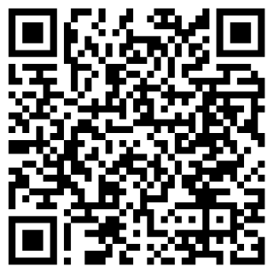
School Uniform Information Guide.
Vista Academy
Scan the QR Code to find the school page!
For delivery before Back to School, please order by:
Wednesday 12th August 2026

Slide 2
Dear Parents & Carers…
We always encourage parents to order as soon as possible to ensure you will have the correct uniform for Back to School. You will see the QR code to order your school uniform on the front page of this booklet. Our delivery times during our “peak season” are 10 working days however, these can be longer as we move closer to Back to School.
Our shop in Peterborough is open Monday to Friday 9am till 5pm. (during the summer holidays we open on Saturdays 10-4pm)
We are here to help you if you have any questions, please call our Schools Team on 01733 394758, contact us via live chat on our website or email customerservices@totalclothing.co.uk who will be happy to advise you.
Kind Regards
Abi, Christine, Janet, Mollie, Carol, Babs, Sophie and Ryan
The School Teams, Total Clothing (part of F.R. Monkhouse Ltd)
Buying school uniform can be a tricky task, so here at Total Clothing we have created our School Uniform Information Guide to help you make the process easy for you.
Inside you will find:
Hints and tips on measuring to help you get the right fit first time.
How to place your school uniform order on-line – ensure you place by Wednesday 12th August to receive in time for Back to School.
Ways to get in touch with our Schools Team.
Our Top Uniform Tips.
Our shop location in Peterborough.

Slide 3
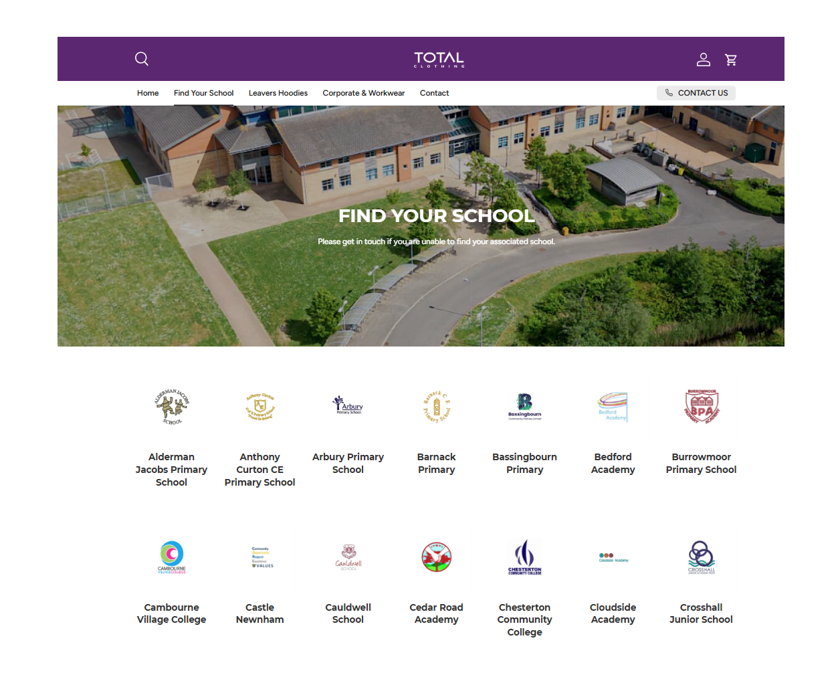



How to purchase your uniform…
How to purchase your uniform…
Click on the link in this guide or go to TotalClothing and find your school.
Click & collect from our shop or have your uniform delivered to your home.
Phone
Please call
01733 394758
Live Chat
Please visit our
website TotalClothing
Phone
Please call
01733 394758
Email
Please email directly customerservices@
totalclothing.co.uk
Returns policy:
We have a returns policy of 28 days from your purchase to return or exchange your garments. It would be great if you could send your returns as soon as possible to help our stock levels.
Returns policy:
We have a returns policy of 28 days from your purchase to return or exchange your garments. It would be great if you could send your returns as soon as possible to help our stock levels.
Where to purchase!

Slide 4
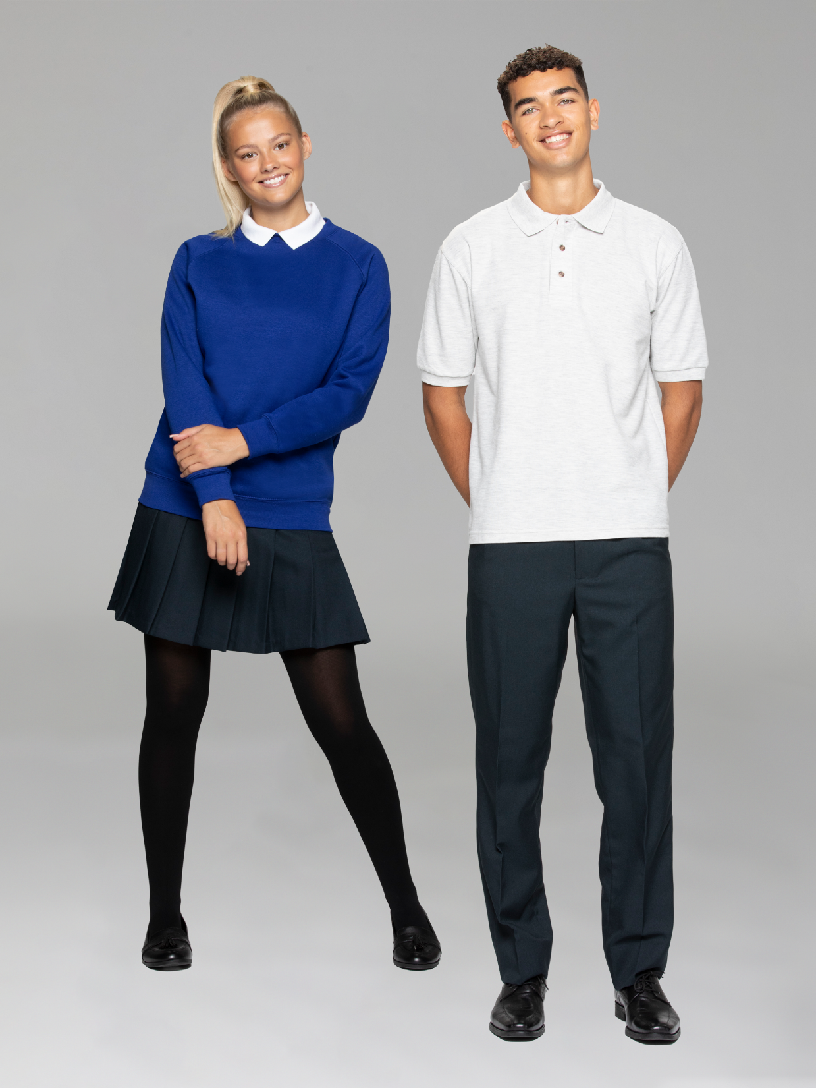
How to measure your child for school uniform…
Collar
Chest
Chest:
Place the tape measure under the arms and measure the chest at the fullest part.
Waist
Collar:
Measure around the base of the neck where the collar sits.
Hips:
Measure around the bottom, at the fullest part.
Hips
Inside Leg:
Measure from the crotch to the top of the shoe.
Inside Leg
Waist:
Measure around the natural waistline – where you would normally wear your trousers or skirt.

Slide 5
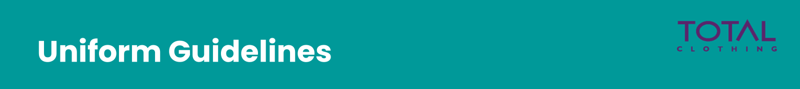
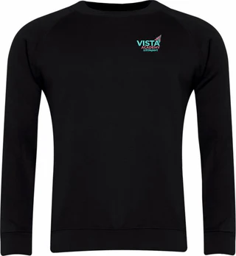
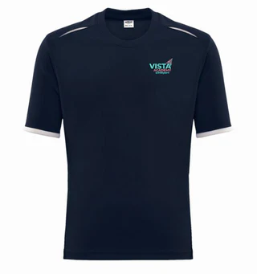
Uniform (Compulsory):
White polo shirt with Vista logo
Black sweatshirt with Vista logo
Plain black trousers, A-line/pleated skirt, or tailored black shorts
Any socks (black recommended)
Plain black shoes (including trainers with no visible branding)
PE Kit (Compulsory):
PE top with Vista logo
¼ zip top with Vista logo
Plain black or navy shorts, tracksuit bottoms, or sports leggings
Sports socks
Indoor trainers or studded boots, depending on activity
General Appearance:
Jewellery: Only one small stud per ear and a watch allowed. Nose piercings must have a clear retainer.
Makeup: Must be discreet. Excessive makeup, false nails, and nail extensions are not permitted.
Hair: Extreme styles or unnatural colours are not allowed.
Hoodies: Only permitted if school-issued and worn for approved activities.

Slide 6
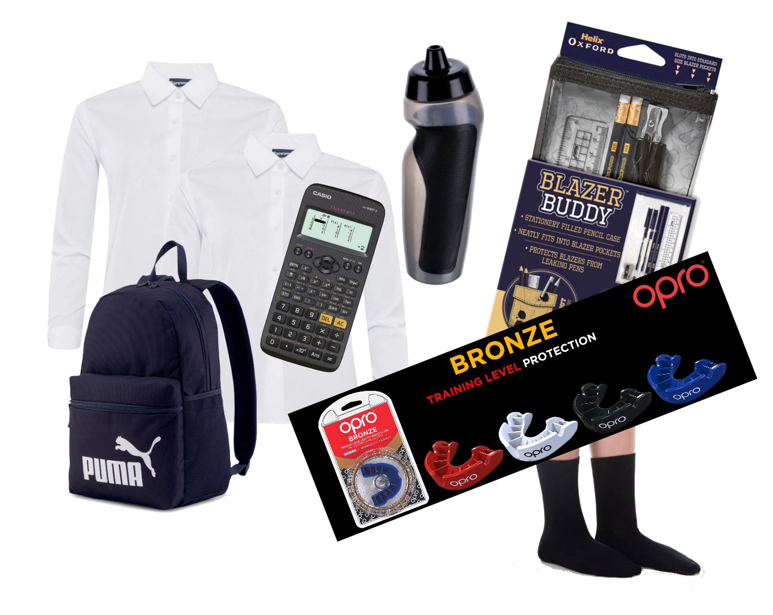
Did you know that we also sell all the Essential & Accessories you may need?
Backpacks
Helix Stationary
Calculators
Iron on Name Labels
Shirts & Blouses
Water Bottles
Gumshields
Shin Guards

Slide 7




Building a greener and fairer future…
We are committed to doing the right thing for the planet and our people, to ensure we build fairer and greener future together.
Our boys shorts and trousers are made from 65% recycled polyester and up to 11 plastic bottles are recycled to make the polyester.
Our sweatshirts and cardigans are made from 55% recycled polyester and up to 11 plastic bottles are recycled to make the polyester.
We are doing our very best to ensure all packaging is sustainably sourced by 2025. By Back to School 2025 we could have saved 50 million+ bottles from landfill.
Total Clothing – Share – Reuse - Recycle
As part of our recycling programme, we partnership with schools overseas and the UK to ensure that no garments enter landfill.

Slide 8
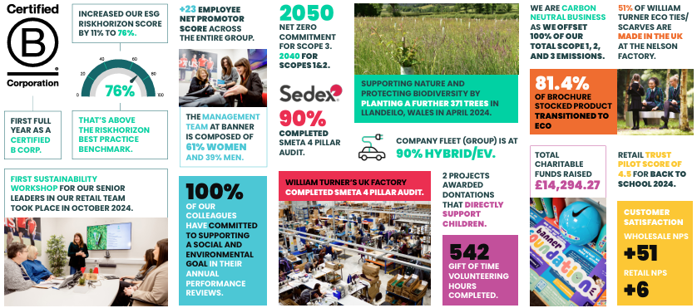
Our recent group achievements:

Slide 9

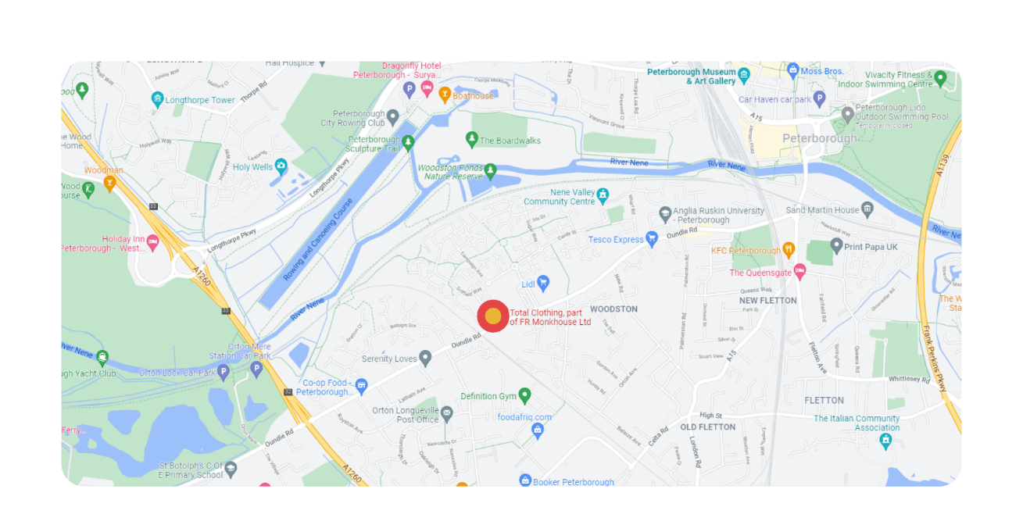
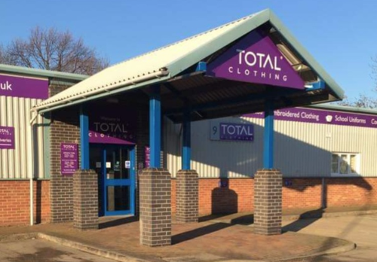
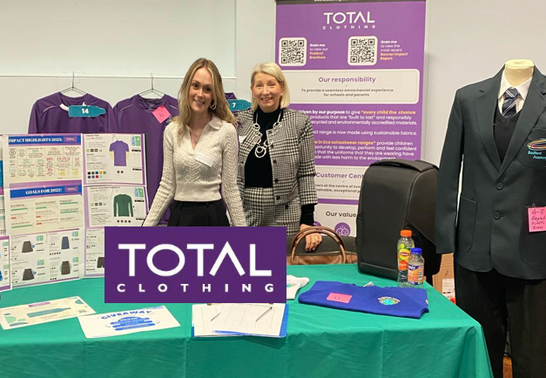
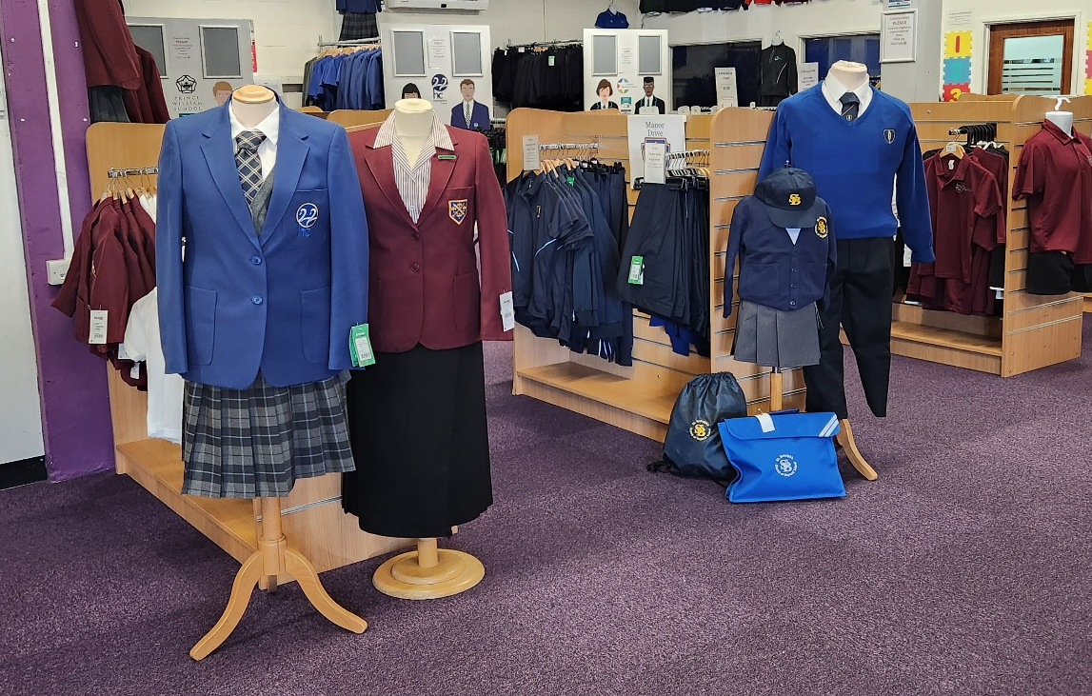
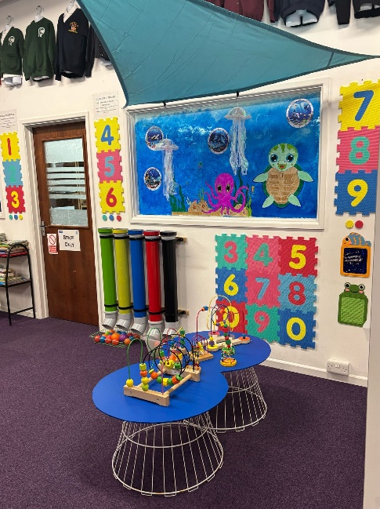
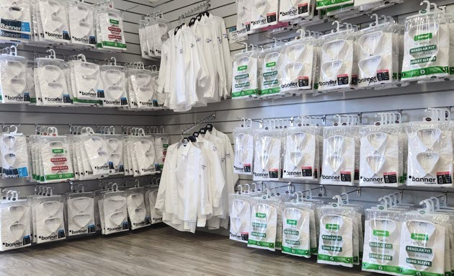
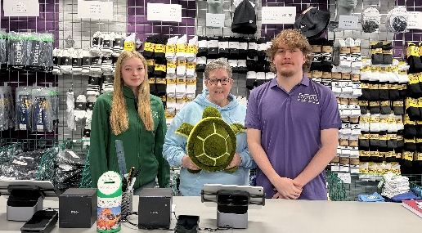
Visit us in store…
School Shop Opening Times:
Monday – Friday: 9am – 5pm
During the summer holidays we are open on a Saturday from 10am till 4pm.
Where to find us:
No.9 Botolph Trading Estate, Oundle Road, Peterborough, PE2 9QP

